Slide 1
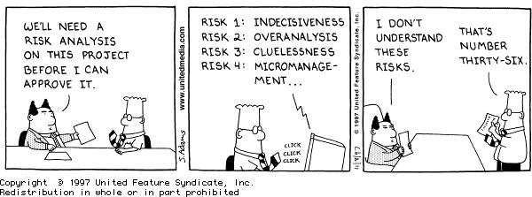

Agile Risk Management
CSSE579
Session 5
Part 4
With a review of what we’ve done so far, in the final slides

Slide 2
Ok, not rocket science here
Figure out what problems you might have
Estimate how problematic they would be and likely they are to happen
If they are more problematic than makes you feel comfortable (i.e. if they exceed your “Risk Referent”) then do something about them
Obviously it’s better if your process prevents risks rather than simply planning for extra time BUT even that’s better than walking off a cliff
The difficult part is:
  Knowing what’s at risk
  Preventing it from being a problem

Slide 3
Philips’ Frequent Sources of Risk
Personnel shortfalls
Unrealistic schedules and budgets
Developing the wrong software functions
Developing the wrong user interface
Goldplating (paying to much attention to what the customer wants changed)
Continuing steam of requirements changes
Shortfalls in externally furnished components
Real-time performance shortfalls
Straining computer science capabilities
Notes:
Get people to go to the board and indicate projects that have had this risk
Get people to come up with ways to prevent this risk
Get people to come up with risks not on this list

Slide 4

Highsmith’s Sources of Risk
These are from DeMarco’s book (2003):
Inherent schedule flaws
Requirements inflation (creep)
Employee turnover
Specifications breakdown
Poor productivity
Notes:
See APM pp 182-5 reading.

Slide 5
1. Highsmith’s remedies for schedule risk
Team involvement in planning and estimating
Early feedback on delivery velocity
Constant pressure to balance the number and depth of features with capacity constraints
Close interaction between engineering and customer teams
Early error detection/correction to keep a clean working product

Slide 6

2. And for feature creep
It’s not creep, it’s growth.
Needs to be a joint effort, not features added indiscriminately.
Highsmith says, “Not as dangerous as he looks…”
Notes:
Image from http://beforeitsnews.com/business/2012/09/watch-out-for-this-insidious-startup-project-malady-2454052.html

Slide 7

3. Employee turnover?
Better in agile projects:
  More collaboration
  Pair programming
  Higher morale
To ameliorate,
Highsmith recommends:
  Cross-training and
  Documentation!
This one’s really two problems – people leaving and people arriving.
Notes:
Revolving door image from http://www.recourseresource.com/blog/stop-recruiting-start-retaining/

Slide 8

4. Specification breakdown?
APM insists on a product manager.
They need to resolve spec conflicts.
  Aided by an executive sponsor
“They claim tha this should work, somehow.”
Notes:
Image from http://www.dwg-us.com/blog/pm-insights-top-3-responsibilities-of-an-executive-project-sponsor/

Slide 9

5. Poor productivity?
Agile emphasizes getting the right people on the team, to begin with.
The fast iterations drive productivity.
Agile – Riding the plasma wave
Notes:
Image from http://www.sciencedaily.com/releases/2012/07/120718122303.htm

Slide 10
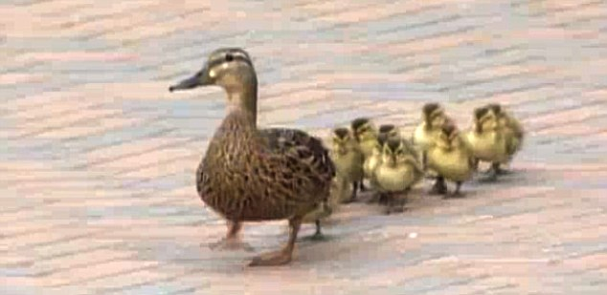
Leadership required
How to be visionary and positive, while
Also being brutally honest about risks
  Denial leads to surprise
  But constant attention to risk is demoralizing
Notes:
Ducks from http://www.dailymail.co.uk/news/article-1336059/Mother-ducks-10-ducklings-swept-away-powerful-gust-wind-Woodbine.html

Slide 11
Better and worse with agile
Short planning and delivery iterations:
  Reduced risk of losing customer involvement
  Less up-front wasted time from project changes
  But also can have major rework due to oversights
  Scope oscillation is a problem from hurried customer interaction
  Increased cost of frequent changes

Slide 12

Highsmith argues it’s “new work”
Can’t be made risk-free
No one knows for sure if it can be built to spec
“In the next iteration, go ahead and make these into a single tool…”
Notes:
Image from http://www.apriliaforum.com/forums/showthread.php?265463-Rear-shock-preload-tool

Slide 13
Additional tips from Techwell article
Risk management in agile is “inferred” rather than explicit, but
Standup meetings are designed to air risks.
Retrospectives provide another opportunity.
Sizing-up a sprint exposes risks.
The responsibility to spot risks should be shared across the team.
Notes:
Article is at http://www.techwell.com/2014/04/managing-risk-agile-project.

Slide 14
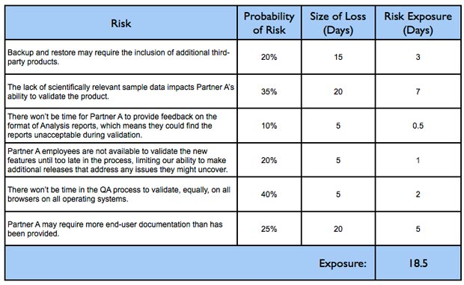
A good idea for agile? (part 1)
Notes:
From http://www.mountaingoatsoftware.com/blog/managing-risk-on-agile-projects-with-the-risk-burndown-chart

Slide 15
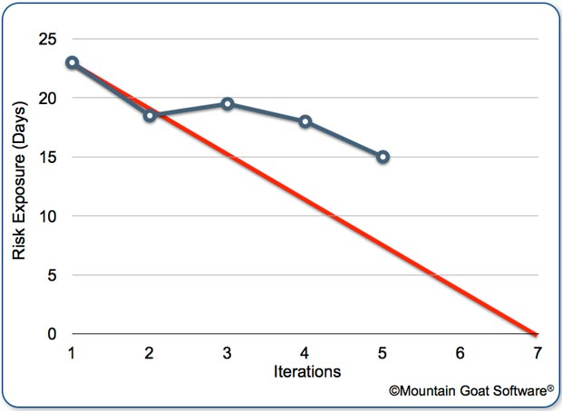
A good idea for agile? (part 2)
Risk burndown chart
Notes:
From http://www.mountaingoatsoftware.com/blog/managing-risk-on-agile-projects-with-the-risk-burndown-chart

Slide 16
Our learning outcomes
Re-repeated
Key principles of agile project management – Wk 1
Agile software life cycle processes – Wk 1 & 2
Agile software project estimation – Wk 4
Software risk planning and management – Wk 5
Agile software project planning – Wk 3
Managing software projects to a plan - Wk 5
Forming and managing project teams
Progress, Program/Portfolio Management – Wk 6
Adv. Topics: Earned Value, Critical Chain
– Wk 4
10. Project management and requirements – Wk 4
11. Project management and design
12. Project management and testing
Things I added!

Slide 17
Some specific topics / skills to learn!
Re-repeated
Within the above framework of outcomes…
Understand program management concepts and strategic goals. Wk 6
Create and maintain software plans and schedules. Wk 5
Select a software life cycle model and methodology to include traditional and agile concepts. Wk 2
Develop software cost estimates and proposals. Wk 4
More →

Slide 18
Some specific topics / skills to learn!
Re-repeated
Build, develop, and maintain a software team, including:
  Acquire the software staff.
  Build a team communication plan and "run" rules.
  Assign responsibilities for all functional / team areas. Wk 5
  Arrange for training for the software team.
  Negotiate involvement of all project groups in the software activities.
  Plan for staff transitions.
More →

Slide 19
Some specific topics / skills to learn!
Re-repeated
Identify software risk and develop risk management plans. Wk 5
Special topics to consider:
  Software maintenance versus development.
  Earned value management. Wk 4
  Configuration management. Wk 2
  Planning for continuous integration and automation.
  Project measurements. Wk 5
  Ethical decision making.
  New trends.
So, what are your priorities for weeks 7, 8, 9, and 10?

